Slide 1
Feeding the Living
Body & Soul:
Rocket Fuel
for your Super Hero & Genius Self
AhhhMuse, Inc

Slide 2
A Revolutionary Guide to Supporting Ourselves
Everything we think, feel, do, say believe and receive fuels us.
Food is just one important part of the way we give and receive energy to fuel ourselves body, mind & soul.
Choosing live food and daily practices that link us with our own genius brain bring us a lifestyle full of vibrant energy and endless potential.
Feeding the Living Body & Soul approaches nourishing the self in a completely new and comprehensive way that unites the deepest layers of the soul with all parts of the body with practical applications as well.

Slide 3
Now is the Time!
Americans have become increasingly interested in achieving health and maintaining longevity through natural methods.
Health challenges such as obesity, heart disease, cancer, diabetes and arthritis affect as many as 117 million people according to CDC estimates. (CDC Chronic Disease Overview, 2012)
  CDC estimates also indicate that between 27.1 and 52.3 million Americans include Complimentary (Alternative) Health Approaches into their self-care regularly. (CDC NCHS Data, Number 146, April 2014)
  A Gallup poll indicated that 45% of Americans actively try to include organic foods in their diet (Eating Organic Foods Among Various Demographics, Gallup, August, 2014)
Retailers like Wal-Mart and Whole Foods have developed merchandising strategies that leverage these modern realities while supporting public health.

Slide 4
Rocket Fuel & Super Heroes
The evolution of humans, our environment and the planet have created opportunities for us to move beyond science into a realm of empowered vitality.
Super Hero and Genius Brain are states of being (multi-dimensional process stepped down to 3rd dimensional vibration on the grounded functional linear plane) we are all capable of attaining (or remembering- almost innate just not activated in most). The most important action is to choose this path in very single perfect, precious breath and then refine our habits and practices.
Rocket Fuel is absolutely insisting on feeding ourselves, body and soul, with the most positive, affirming, transforming fuel possible.
Choosing tools, practices and fuel that expand our consciousness and life force energy brings us into harmonious relationship with all living things; Plants, Animals, and Ourselves.

Slide 5
The Alchemy of Understanding Food
We all learn from foods we ingest. Some foods help us feel great as soon as we eat them, others might not digest easily or not mesh well with our constitutions. These are messages based upon the energy of food, and although we do not always pay attention to them, they are real!
Super Heroes who choose to consume Rocket Fuel listen and honor the energy messages that plants send us before and while they become fuel.
When we choose to embrace these messages that are gifts from the Plant kingdom, we unite body & soul harmoniously and co-create vitality!
Our Genius Self is the part of us that lives in the present moment and readily knows our personal truth. When we are spontaneous, joyful, playful and free we are most connected to our Genius Self. Who wouldn’t want to live life in this way? We all do, and resources like Feeding the Living Body & Soul help us remember the path to reconnecting and blossoming with our Genius Self.

Slide 6
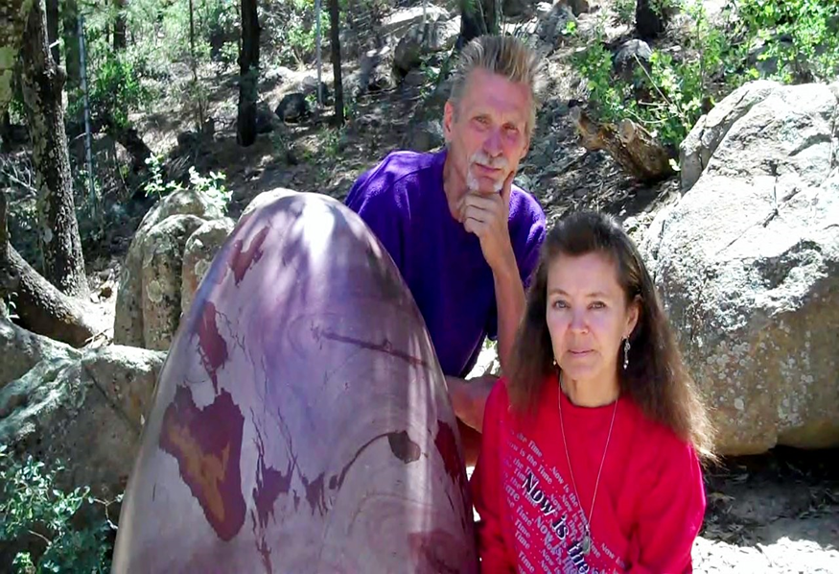
Who We Are
Marilyn & Tohmas Twintreess live 100% off-the-grid in the wilderness of New Mexico .
They are the founders of AhhhMuse, Inc. and Elementals of Life (501c3), sponsor of the international peace project, Peace Across the Planet.

Slide 7
Who We Are
The Twintreess:
  Authored and published 11 books in the US and Japan;
  Have been the subject of decades of radio, television, internet and magazine coverage;
  Lead workshops continually both in the US and internationally;
  Have documented countless cases of fostering healing in humans and Animals with advanced emotional and health crises;
  Offer diverse and inventive listening tools and resources to support the broadest range of needs.

Slide 8
Messages of Compassion as a Path to Vitality
Feeding the Living Body & Soul: Rocket Fuel for your Super Hero & Genius Self is a vehicle for bringing the gifts of tools, practices and messages from the Plant kingdom in a beautiful and digestible format for every willing reader.
The messages and personal experiences included in the book inspire readers to re-evaluate their relationships with themselves, their food and the world around them.
Whether changes result quickly or over time, the messages in Feeding the Living Body & Soul bring compassion and presence into every aspect of life. All that has to occur is to choose!

Slide 9
In Closing…
Feeding the Living Body & Soul: Rocket Fuel for your Super Hero & Genius Self is already helping people with chronic disease and those seeking an improved quality of life.
The time is now, to bring Feeding the Living Body & Soul: Rocket Fuel for your Super Hero & Genius Self to an even broader segment of the population to support healing and vitality for all.

